Slide 1
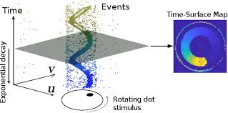

Midterm Presentation Denoising Event Cameras
Students: Bar Weiss, Asaf Omer
Supervisor: Yonatan Shadmi
Semester: Spring, 2022
Date: 12/06/22
In collaboration with: Rafael Advanced Defense Systems via Nimrod Kruger

Slide 2
Agenda
Background
What is an Event Camera?
Applications
Project Goal
Noise models
Shot noise, hot pixels, dark current, etc.
Suggested filtering method(s)

Slide 3
Background

Slide 4
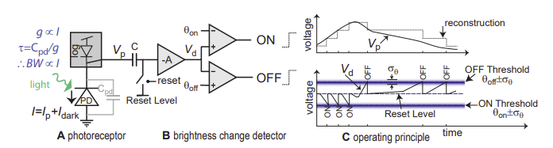
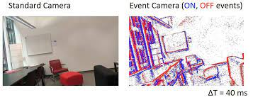
What is an Event Camera?
Event Cameras detect changes in brightness levels, allow fine temporal resolution and high dynamic range
Mechanism
Example of Data
Yuhuang Hu et al, “v2e: From Video Frames to Realistic DVS Events”

Slide 5
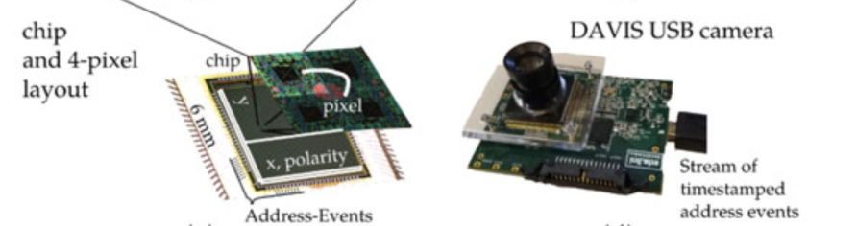
Advantages
High temporal resolution
Sparse data Representation
Low power vision sensing
High Dynamic Range
Guillermo Gallego et al, “Event-Based Vision: A Survey”

Slide 6
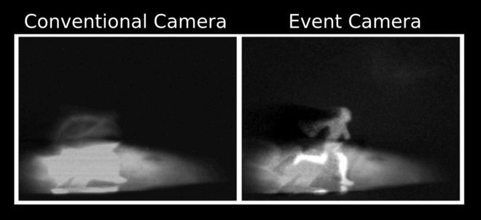
Applications
Autonomous vehicles
Object recognition
Object Tracking
Robotics
Surveillance

Slide 7
Challenges
Limited research was done
Lacking Noise models (our project)
Different representation does not allow reuse of VIS algorithms
Difficult to Synchronize with traditional visual sensors

Slide 8
Project Goal
Characterize noise sources in DVS
Develop mathematical model for each noise source
Offer a denoising algorithm for one (or more) noise source

Slide 9
Noise Sources
Shot noise
Threshold mismatch
Hot pixels
Leak noise events
Dark current
Notes:
Bar – dark current, shot noise, 1/f noise
Asaf – Hot pixels, leak noise events, Threshold mismatch,

Slide 10
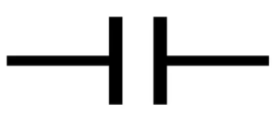
Shot Noise
Cause: the quantum nature of photon absorption in photodiodes causes some of the photons to not generate an electron in the diode.
Electron generated with probability p
When “full” event generated
Event
e
e
e
e
e
e
e
e
e
e
e
e

Slide 11
Shot Noise Effects
In event cameras on contrary to regular cameras shot noise affects the latency of events instead of the illumination
Real events might be “missed” because fewer photons are absorbed.

Slide 12
Shot Noise filtering idea
Probably the most challenging noise to filter in this scenario
For each arriving event there will be a need to estimate the actual time it occurred

Slide 13
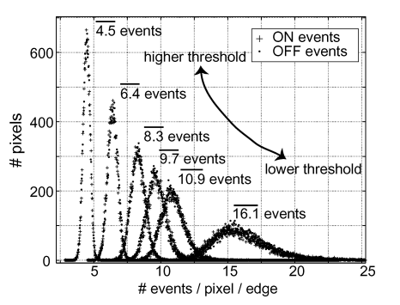
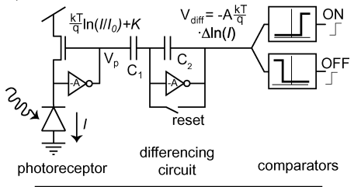
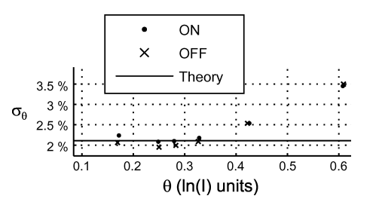
Threshold Mismatch
Cause: in a non-ideal manufacturing process, the threshold value to trigger events is not deterministic.
Mismatch higher in transistors, reset and comparator circuits more susceptible
Higher threshold = more severe mismatch
Lichtsteiner, P; Posch, C; Delbruck, T, “A 128× 128 120 dB 15 μs latency asynchronous temporal contrast vision sensor”

Slide 14
Threshold Mismatch Filtering
Changing threshold to minimize effect is not ideal.
Designing a calibration process could assign a more precise threshold for each pixel.
Even still filtering is a challenge (events are binary)

Slide 15
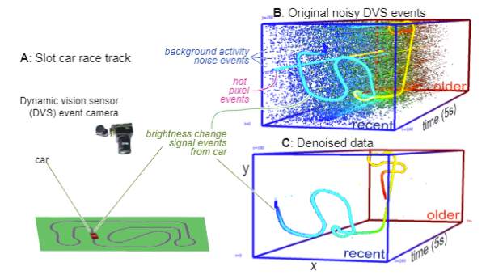
Hot Pixels
Cause: some pixels continuously trigger false events, even with no input. Defective thresholding / reset.
Pixel firing across entire time frame
Shasha Guo and Tobi Delbruck, “Low Cost and Latency Event CameraBackground Activity Denoising”

Slide 16
Hot Pixels Filtering
Easiest noise to detect and filter out.
High pixel self-correlation across any time frame.
Can be pre-filtered with calibration method.
Real time filtering could have benefits (power), but large look-back window.

Slide 17

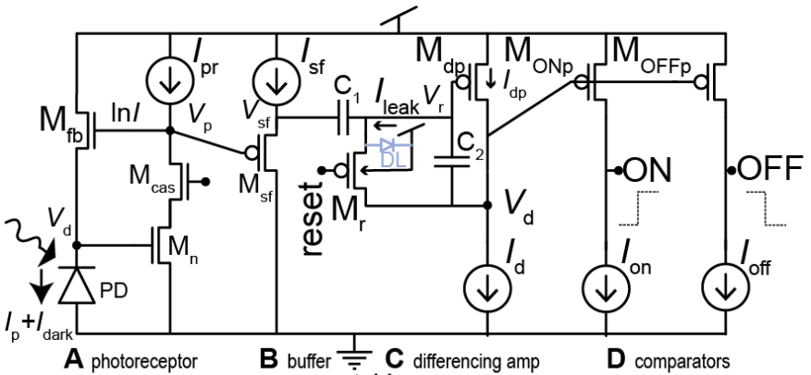
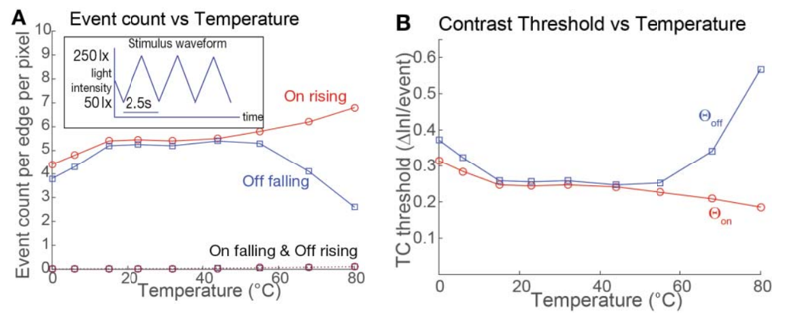
Leak Noise Events
Cause #1: Junction leak current amplified in reset circuit.
Cause #2: Parasitic photocurrent in reset transistor (in non-ideal lighting conditions)
Yuji Nozaki and Tobi Delbruck, “Temperature and Parasitic Photocurrent Effects in Dynamic Vision Sensors”

Slide 18
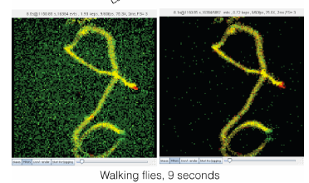
Leak Noise Filtering
Literature usually refers to leak noise as part of "Background Activity".
Usually filtered out through low correlation with neighborhood look-back window.

Slide 19
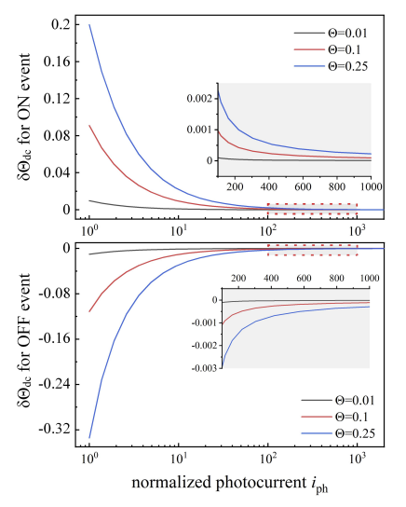

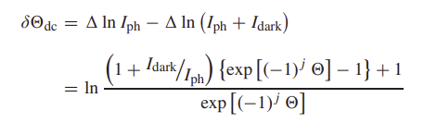
Dark Current
Cause: leakage current in the photodiode that causes the capacitor to charge and emit random noisy events.
This noise has a smaller effect in brighter lighting conditions.
Jiangtao Xu et al, “Analysis of Input-Dependent Noise in Self-Timed Reset Dynamic Vision Sensor and Its Impact on Data Quality”
Notes:
הרבה פעמים מתייחסים לdark current ו-leak noise ביחד, אנחנו בחרנו להפריד בגלל ההשפעה של עוצמת ההארה על ה-dark current בלבד.

Slide 20
Dark Current Filtering
Dark current falls into a category of background activity noise, therefore previously referred methods are useful.

Slide 21
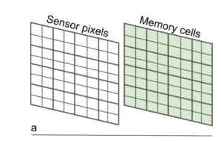
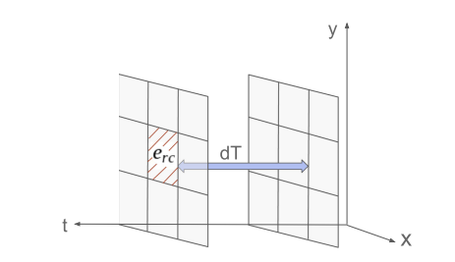
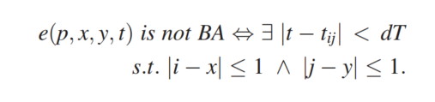
BA filtering example
We Assume that noisy events have low correlation with past events.
Go through all events and delete uncorrelated events
Alireza Khodamoradi et al, “O(N) Space Spatiotemporal Filter for Reducing Noise in Neuromorphic Vision Sensors”
Notes:
להתייחס בעל פה לסוגי רעשים שהפילטר מסנן, leak noise & dark current

Slide 22
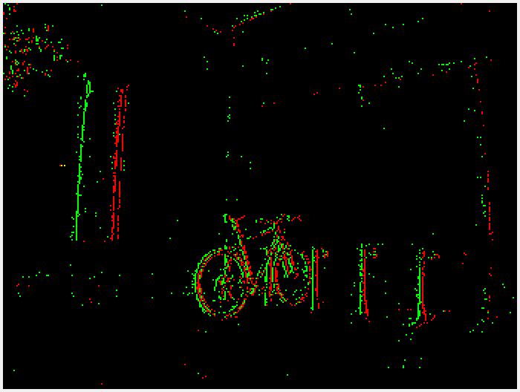
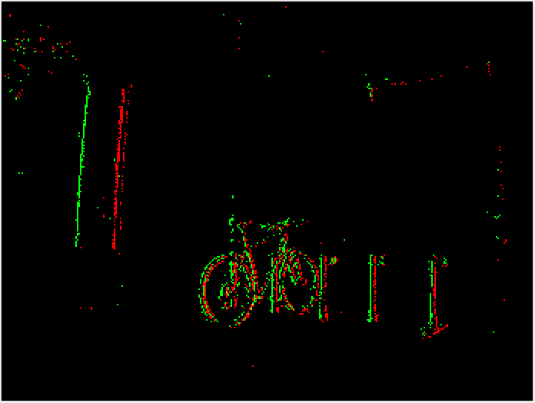
Filtered Frame - Bike
Raw Data
Filtered Data

Slide 23
Future Work – Option 1
Develop statistical models for noise
More focus is needed here some noises require deeper understanding of circuits and physics
Theoretical approach
More effort required in literature survey
Less practical results

Slide 24
Future Work – Option 2
Focus on denoising algorithms
More hands on
Develop performance criteria (like PSNR, SSIM, etc.)
Use statical knowledge to tune filter parameters
Focus on one noise source\type
For Hot pixels and threshold mismatch working with physical camera to develop calibration process

Slide 25

Thank You!

